Slide 1

Welcome to Spring 3.0 Chapter 2 - AOP

Slide 2
Chapter 2 – AOP
Aspect Oriented Programming (AOP) | Structured vs. OOP vs. AOP
 | AOP Weaving
 | AOP Proxy
 | AOP Terminologies
 | Types of Advices
 | Code samples

Slide 3
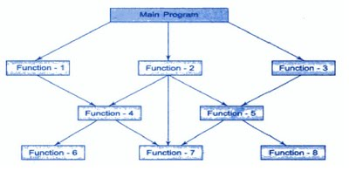
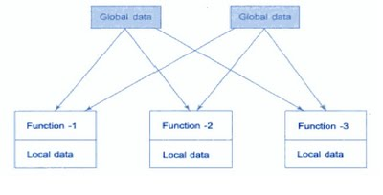
Programming Techniques
Structured(FP, POP)
Structured programming is an old term that would encompass functional, procedural, and much else. It basically means using explicit control-flow structures rather than jumping about directly from instruction to instruction.
Functional and procedural programming are both, in that sense, structured paradigms.
Object A
Object B
OOP
Data
Data
Communication
Functions
Functions
Data
Functions
Object C
Notes:
Structured programming is an old term that would encompass functional, procedural, and much else. It basically means using explicit control-flow structures rather than jumping about directly from instruction to instruction. Functional and procedural programming are both, in that sense, structured paradigms.

Slide 4
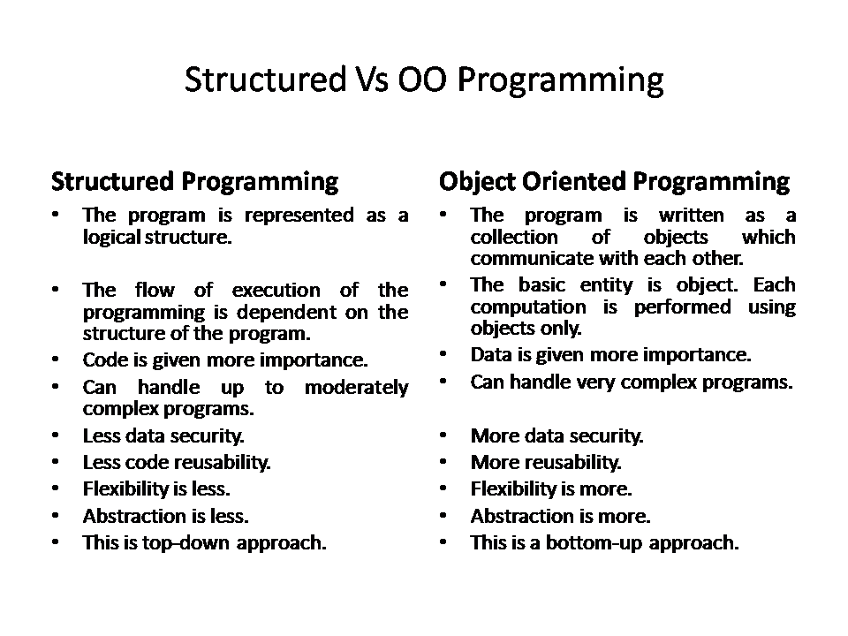
Programming Techniques
Ease of modification
Notes:
Primary concern vs secondary concern

Slide 5
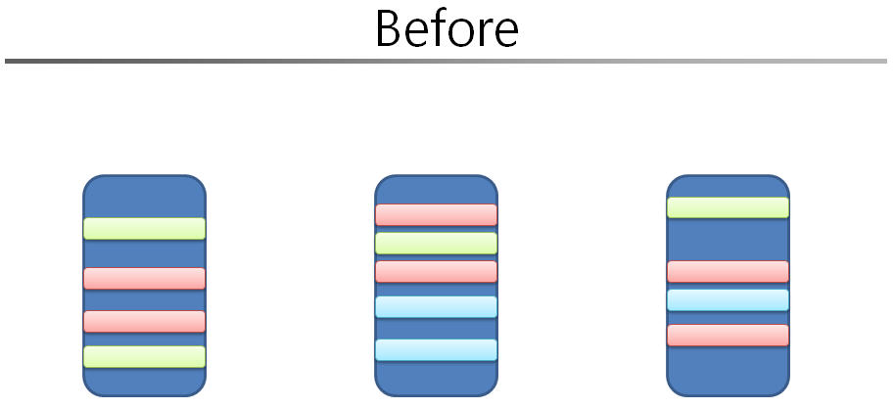
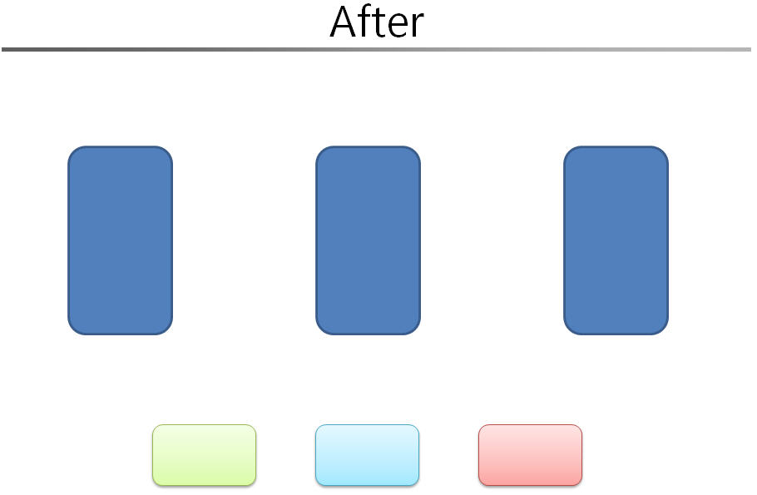
Aspect Oriented Programming
OOP
Application Code sprinkled with secondary/cross cutting concerns
AOP
Primary Concerns
Aspects(cross cutting concerns)
Notes:
Aspect-Oriented Programming (AOP) complements Object-Oriented Programming (OOP) by providing another way of thinking about program structure. The key unit of modularity in OOP is the class, whereas in AOP the unit of modularity is the aspect. Aspects enable the modularization of concerns

Slide 6
Aspect Oriented Programming
Aspect-Oriented Programming (AOP) complements Object-Oriented Programming (OOP) by providing another way of thinking about program structure.
The key unit of modularity in OOP is the class, whereas in AOP the unit of modularity is the aspect. Aspects enable the modularization of concerns.

Slide 7
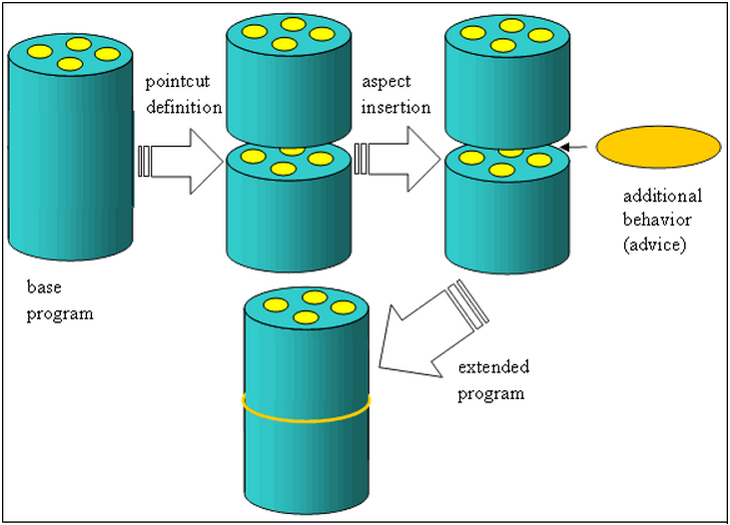
AOP

Slide 8
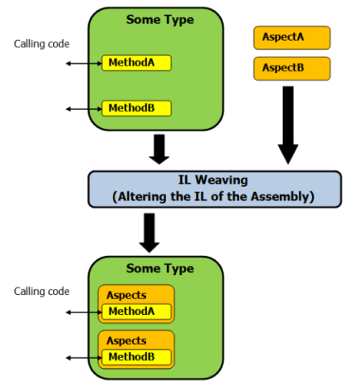
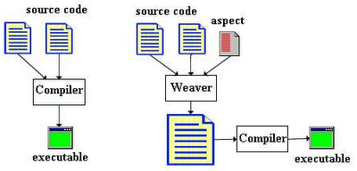
AOP Weaving
Weaving : Linking aspects with other application types or objects to create an advised object. This can be done at compile time (using the AspectJ compiler, for example), load time, or at runtime. Spring AOP, like other pure Java AOP frameworks, performs weaving at runtime.
Weaving
Proxied object
or
Advised object
or
Target object
com.springtraining.springaop1
com.springtraining.springaop2.annotated
Notes:
Show
com.springtraining.springaop1
com.springtraining.springaop2.annotated

Slide 9
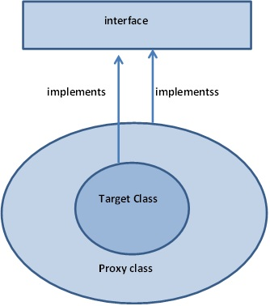
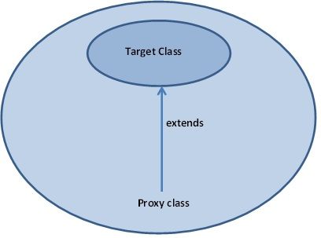
AOP Proxy
Proxy is an object created after applying the advice to the target object(application). Both objects(application and proxy) are same except that advice code is weaved into proxy. [Application or Target+ Advice = Proxy]
com.springtraining.springaop.proxy1.subclass
com.springtraining.springaop.proxy2.interfaced
Notes:
Interface -> JDK dynamic proxies are used and Spring uses the JDK’s java.lang.reflect.Proxy class to generate new dynamic proxy class which implements the interfaces of the target object.
No Interface -> If Target object does not implement any interface then CGLIB proxies are used. Using CGLIB Spring generates a subclass of the target class and binds the advices and finally propagates method call to target class
JDK proxies versus CGLIB proxies :
Using CGLIB has a limitation that methods marked as final in target class can’t be advised as final methods can’t be overridden (CGLIB creates a subclass of target class at runtime) but this limitation disappears in case of using JDK dynamic proxies.
Using CGLIB is favoured when dealing with legacy code where target classes do not implement any interfaces.
JDK proxy mechanism leads to loosely coupled application because interfaces of target class are used in generating proxies. JDK dynamic proxies are favored over CGLIB.
Constructor of your proxied object is called twice in CGLIB proxies but not in JDK proxies

Slide 10
AOP Proxy
Interface -> JDK dynamic proxies are used and Spring uses the JDK’s java.lang.reflect.Proxy class to generate new dynamic proxy class which implements the interfaces of the target object.
No Interface -> If Target object does not implement any interface then CGLIB proxies are used. Using CGLIB Spring generates a subclass of the target class and binds the advices and finally propagates method call to target class
JDK proxies versus CGLIB proxies :
Using CGLIB has a limitation that methods marked as final in target class can’t be advised as final methods can’t be overridden (CGLIB creates a subclass of target class at runtime) but this limitation disappears in case of using JDK dynamic proxies.
Using CGLIB is favoured when dealing with legacy code where target classes do not implement any interfaces.
JDK proxy mechanism leads to loosely coupled application because interfaces of target class are used in generating proxies. JDK dynamic proxies are favoured over CGLIB.

Slide 11
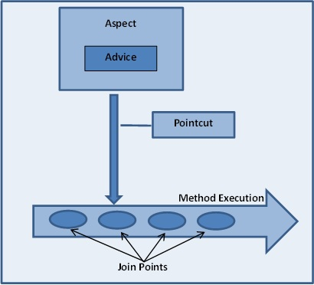
AOP Terminology
When we weave,
advice of an aspect
to the pointcuts
of a joinpoint( expression)
to a target object,
it becomes proxy(advised object)

Slide 12
AOP Terminologies
Terms | Description
Aspect | A module which has a set of APIs providing cross-cutting requirements. For example, a logging module would be called AOP aspect for logging. An application can have any number of aspects depending on the requirement.
Join point (Where) | This represents a point in your application where you can plug-in AOP aspect. You can also say, it is the actual place in the application where an action will be taken using Spring AOP framework.
Advice (How- Aspect code) | This is the actual action to be taken either before or after the method execution. This is actual piece of code that is invoked during program execution by Spring AOP framework.
Pointcut(Collection of JP) | This is a set of one or more joinpoints where an advice should be executed. You can specify pointcuts using expressions or patterns as we will see in our AOP examples.
Target object | The object being advised by one or more aspects, this object will always be a proxied object. Also referred to as the advised object.
Weaving | Linking aspects with other application types or objects to create an advised object. This can be done at compile time (using the AspectJ compiler, for example), load time, or at runtime. Spring AOP, like other pure Java AOP frameworks, performs weaving at runtime.
com.springtraining.springaop3.annotatedpointcut
com.springtraining.springaop4.annotatedpointcut
Notes:
When we weave, advice of an aspect to the pointcuts of a joinpoint to a target object, it becomes proxy(advised object)

Slide 13
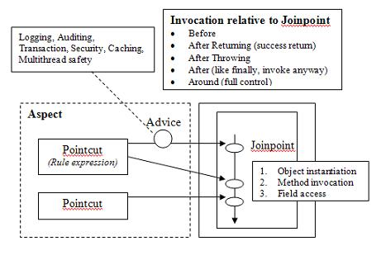
AOP Terminologies

Slide 14
AOP - Types of Advice
Advice | Description
before | Run advice before the a method execution.
after | Run advice after the a method execution regardless of its outcome.
after-returning | Run advice after a method execution only if method completes successfully.
after-throwing | Run advice after the a method execution only if method exits by throwing an exception.
around | Run advice before and after the advised method is invoked.
com.springtraining.springaop.types1
com.springtraining.springaop.types2
com.springtraining.springaop.types3
Notes:
com.springtraining.springaop.types1
com.springtraining.springaop.types2
com.springtraining.springaop.types3

Slide 15
Spring AOP - Misc
Wont work on final Methods in case of CGLIB proxying which isn't interface based.
Spring AOP is only meant for methods and not for fields.
Spring AOP will never strive to compete with AspectJ to provide a comprehensive AOP solution(although Spring AOP is quite capable).
AspectJ and/or Spring AOP
@AspectJ annotation-style approach vs. the Spring XML configuration-style approac
Notes:
Spring AOP will never strive to compete with AspectJ to provide a comprehensive AOP solution. We believe that both proxy-based frameworks like Spring AOP and full-blown frameworks such as AspectJ are valuable, and that they are complementary, rather than in competition. Spring 2.0 seamlessly integrates Spring AOP and IoC with AspectJ, to enable all uses of AOP to be catered for within a consistent Spring-based application architecture. This integration does not affect the Spring AOP API or the AOP Alliance API: Spring AOP remains backward-compatible.

